Slide 1
Presented by:
Lu Torres
Community and Economic Development Specialist
Broadband Coordinator
Introduction to the USDA and Overview of
Rural Utilities Service Programs
Nevada Economic Development Conference
Atlantis Casino Resort
August 20, 2018

Slide 2
Strategic Objective
“To expand rural business opportunity and rural quality of life with access to capital; improve infrastructure, broadband access and connectivity; and support workforce availability”
Ensure USDA programs are delivered efficiently, effectively, and with integrity and a Focus on customer service.
Maximize the ability of American agricultural producers to prosper by feeding and clothing the world.
Promote American agricultural products and exports.
Facilitate rural prosperity and economic development.
Strengthen the stewardship of private lands through technology and research.
Foster productive and sustainable use of our National Forest System lands.
Provide all Americans access to a safe, nutritious and secure food supply.

Slide 3
FY 2018 Telecommunications Vision and Purpose
We will connect as many rural Americans as possible to enhanced broadband services through our loan and grant programs by September 30, 2018

Slide 4
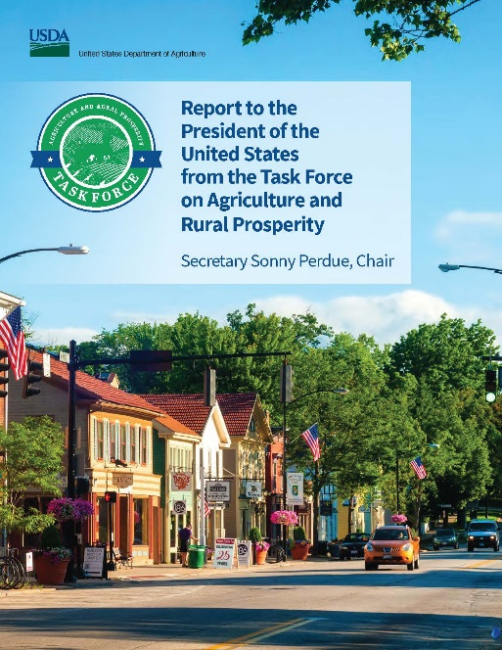
Interagency Task Force on Agriculture and Rural Prosperity
Task Force on Agriculture and Rural Prosperity Report
www.usda.gov/sites/default/files/documents/rural-prosperity-report.pdf
Calls to Action:
Achieving e-connectivity for Rural America
Improving Quality of Life
Supporting a Rural Work Force
Harnessing Technological Innovation
Developing the Rural Economy
More information
www.usda.gov/ruralprosperity
Objectives & Recommended Actions:
Establish Executive Leadership to Expand E-connectivity Across Rural America
Assess State of Rural E-connectivity
Reduce Regulatory Barriers to Infrastructure Deployment
Assess Efficacy of Current Programs
Incentivize Private Capital Investment

Slide 5
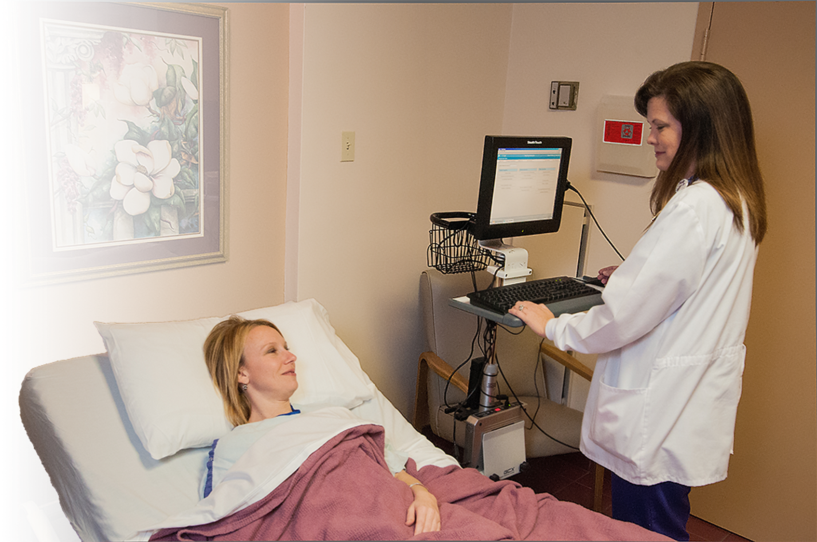
Rural Broadband Loan Programs
Telecommunications Loan Program
Farm Bill Broadband Program

Slide 6
Telecommunications Infrastructure Program
Available Funding | Program Updates
FY 2016 $690 million available in FY 2016 FY 2017 $690 million available in FY 2017 FY 2018 $690 million available in FY 2018 Loans finance new & improved telecommunications infrastructure, primarily for the benefit of rural populations of 5,000 or less <Typically> Loans may serve non-rural subscribers in some cases | FY 2016 14 loans approved: $194.5 million FY 2017 21 loans approved: $427.4 million FY 2018 10 loans approved: $123.7 million 9 loans in process: $105.9 million Pipeline: 19 loans: $229.6 million Applications are accepted year round RD Apply online application system
https://www.rd.usda.gov/programs-services/telecommunications-infrastructure-loans-loan-guarantees
Updated: 07/10/2018
Notes:
"Rural area" is defined as any area of the United States, its territories and insular possessions (including any areas within the Federated States of Micronesia, the Republic of the Marshall Islands, and the Republic of Palau) not included within the boundaries of any incorporated or unincorporated city, village, or borough having a population exceeding 5,000 inhabitants.
RUS loan funds may be approved for facilities to serve non-rural subscribers only if:
1. The principal purpose of the loan is to furnish and improve rural service; and
2. The use of loan funds to serve non-rural subscribers is necessary and incidental to the principal purpose of the loan.

Slide 7
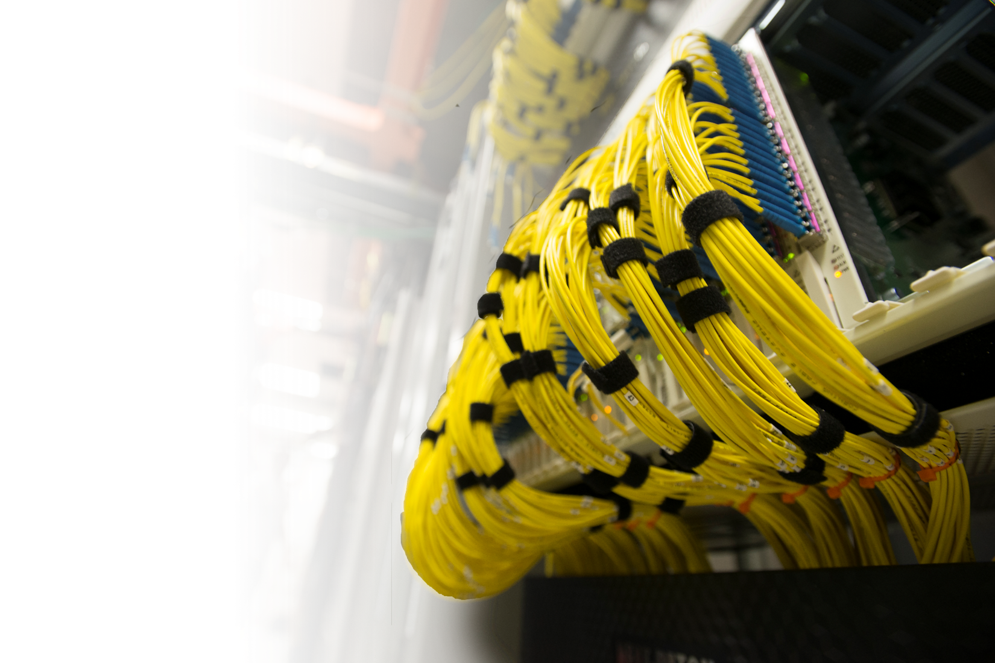
Telecommunications Infrastructure Program
- Did You Know?
Standard Loan Terms include:
2 Year Principal Deferral
Interest Rate at the Cost-Of-Money
Loan Maturity - Life of the Facilities Financed Plus 3 Years
Staff can assist and review loan applications before submission

Slide 8
Telecommunications Farm Bill Broadband Program
(aka Rural Broadband Access Loan and Loan Guarantee Program)
Available Funding | Program Updates
FY 2016 $64 million available in FY 2016 FY 2017 $27 million appropriated in FY 2017 FY 2018 $29.9 million available in FY 2018 * * Additional Carry over funding is available from previous fiscal years Loans finance the costs of constructing a broadband network Amounts from $100,000 to $25 million Broadband Service and Broadband Lending Speed is defined as 25 Mbps (download) and 3 Mbps (upload) Serving rural communities of 20,000 or less <typically> At least 15% of the proposed funded service area households in unserved Cannot have 3 or more incumbent service providers Service area cannot be in a RUS previously funded area | FY 2016 1 loan approved: $4.1 million FY 2017 2 loans approved: $24.0 million FY 2018 1 loan in process: $19.9 million RD Apply online application system NOSA Released on March 28th, 2018 RUS is now accepting applications on a rolling basis throughout FY2018 This will give RUS the ability to request additional information and modifications to a submitted application whenever necessary Applications will be processed on a first come, first served basis Every 90 days, RUS will conduct an evaluation of submitted applications, ranking them based on the percentage of unserved households RUS anticipates that it will conduct at least 2 evaluation periods for FY2018
https://www.rd.usda.gov/programs-services/farm-bill-broadband-loans-loan-guarantees
Updated: 07/02/2018

Slide 9
Telecommunications Farm Bill Broadband Program –Did You Know?
* Loan Amounts between $100,000 & $25 Million.
* Unserved areas: ‘‘Broadband Service’’, the rate used to determine if an area is eligible for funding, shall mean the minimum rate of data transmission of 25 megabits downstream and 3 megabits upstream for both mobile and fixed service.
Applicant Priority: The greatest proportion of unserved households.
* Broadband Lending Speed: Applicants must propose to offer new broadband service at a minimum bandwidth of 25 megabits downstream and 3 megabits upstream for both mobile and fixed service to the customer.
Special Terms and Conditions may apply if more than 50% of the households are unserved:
up to 4 year principal deferral
25% extension to the amortization period of the loan up to 35 years
Standard Loan Terms include:
2 Year Principal Deferral
Interest Rate at the Cost-Of-Money
Loan Maturity - Life of the Facilities Financed Plus 3 Years
* As of the most recent NOFA on March 28, 2018.

Slide 10
SUTA - For All Telecommunications Loan Programs – Did You Know?
Modified Loan Terms for Serving a Substantially Underserved Trust Area (SUTA) include:
At the discretion of Administrator, RUS can modify certain loan terms or application requirements, which may include:
Interest rates as low as 2%, extended amortization period, and/or priority processing
Loan interest rates as low as 2 percent;
Waiver of certain documentation requirements regarding non-duplication of service;
Waiver of matching funds or credit support requirements for loans;
Extension of the time period in which loans are repaid; and
Providing the highest priority for funding to eligible projects that will serve trust areas.
Example Infrastructure Loans financed using SUTA:
FY 2015 -- Mescalero Apache Telecommunications (NM) $5.4 million
FY 2016 -- Sacred Wind Communications (NM) $13.8 million
FY 2017 -- Hopi Telecommunications, Inc. (AZ) $5.82 million

Slide 11
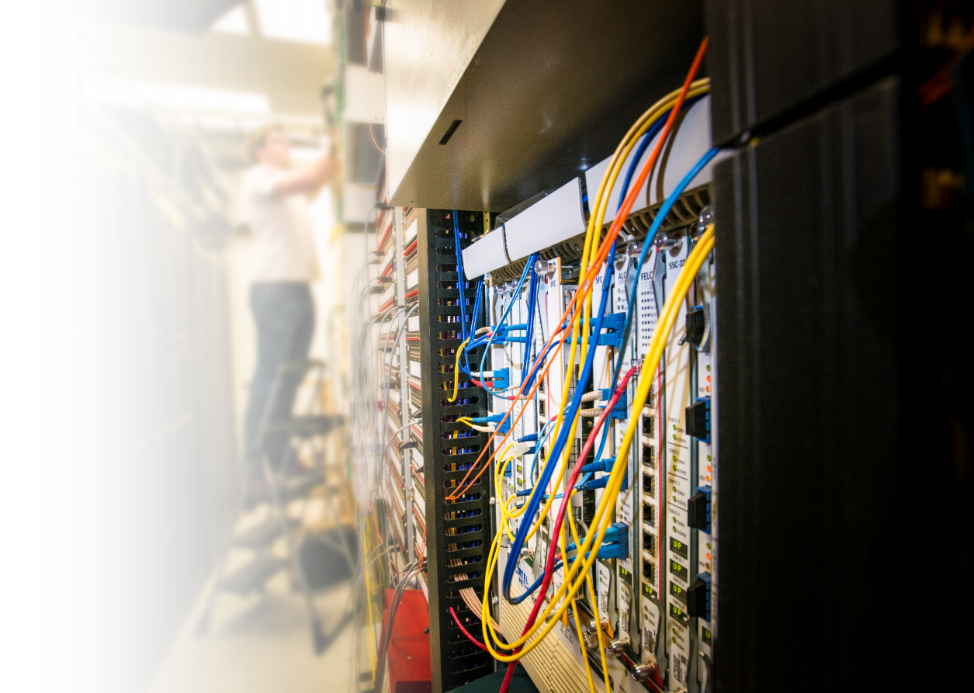
Expanding Broadband in Rural America
A new broadband e-connectivity pilot program was included in the FY 2018 budget signed by the president on 03/23/2018
$600,000,000, to conduct a broadband loan and grant pilot program under the Rural Electrification Act
Specific details of the program will be worked on in the upcoming months
The program will be designed to focus on rural area where at least 90% of the households to be served shall be in a rural area without sufficient access to broadband, defined for this pilot program as 10 Mbps downstream, and 1 Mbps upstream.
Press Release: https://www.usda.gov/media/press-releases/2018/03/23/secretary-perdue-applauds-broadband-investment-included-omnibus
*** Program Details are To Be Determined ***
07/27/2018 Update:
Notice of inquiry and request for Comments published in the Federal Register
RUS is seeking input on several questions concerning the e-Connectivity Pilot
Comments are due on or before 5 PM EDT on September 10, 2018.
Ref: https://www.gpo.gov/fdsys/pkg/FR-2018-07-27/pdf/2018-16014.pdf

Slide 12
Telecommunication Grant Programs
Community Connect Grants
Distance Learning & Telemedicine Grants

Slide 13
Community Connect Program
Available Funding | Program Updates
FY 2016 $11.74 million available in FY 2016 FY 2017 $34.5 million available in FY 2017 FY 2018 $30.0 million available in FY 2018 * * Carryover funding is sometimes available from previous fiscal years General provisions as of the latest NOSA: Grant funds for Broadband Service deployment Population of 20,000 or less Amounts from $100,000 to $3 million Service Area must be entirely unserved Minimum Broadband Service is defined as 10 Mbps (download) and 1 Mbps (upload) Minimum Broadband Grant Speed is defined as 25 Mbps (download) and 3 Mbps (upload) 15% Matching Requirement | FY 2016 Over 70 applications received: $120 million 9 applications approved: $15.6 million FY 2017 48 Applications processed for $90.8 million 15 grants approved: $32.3 million ** ** More grant awards are possible pending final paperwork FY 2018 NOSA Released on March 15, 2018 Submissions were received by May 14, 2018 & are being evaluated 125 Applications received for $225.6 million
http://www.rd.usda.gov/programs-services/community-connect-grants
Updated: 07/10/2018

Slide 14
Distance Learning and Telemedicine (DLT) Program
Available Funding | Program Updates
FY 2016 $23.4 million available in FY 2016 FY 2017 $23.6 million available in FY 2017 FY 2018 $29.0 million available in FY 2018 $20.0 million additional available in FY 2018 in rural areas to help address the opioid epidemic in rural America Grants fund equipment needed to provide Distance Learning and Telemedicine services 15% Matching Requirement Minimum Grant amount: $50,000 Maximum Grant Amount: $500,000 Only grants are available-no loans or combo loan/grants | FY 2016 182 applications received 98 applications approved: $27.7 million 35 States & Territories represented FY 2017 208 applications received by July 17, 2017 86 applications approved: $27.7 million 46 distance learning & 40 telemedicine projects 30 States & Territories represented 71 of 86 (83%) serving Special Consideration Areas FY 2018 NOSA Released on April 3, 2018 Submissions were received by June 4, 2018 & are being evaluated 223 Applications received for $67.6 million
http://www.rd.usda.gov/programs-services/distance-learning-telemedicine-grants
Updated: 06/06/2018
Notes:
FY17 Applications Received: 208
- 158 deemed eligible for funding consideration
- 50 determined to be ineligible
28 states
Alaska, Alabama, Arizona, California, Colorado, Georgia, Illinois
Indiana, Kentucky, Louisiana, Maine, Michigan, Minnesota, Missouri
Mississippi, North Carolina, Nebraska, New Mexico, New York, Oklahoma, South Carolina
South Dakota, Tennessee, Texas, Virginia, Vermont, Washington, West Virginia
62 grants totaling $21,287,811 were given to projects serving Special Consideration Areas.
- 22 trust area/tribal jurisdictional area
- 38 Strike Force County
- 2 Promise Zone
8 grants totaling $1.52 million for funding to provide communication upgrades between ambulances, emergency transportation vehicles and medical facilities.
7 grants totaling $1.30 million for funding to provide counseling services for behavioral health, mental health, physical and intellectual disabilities, lifestyle issues, and substance abuse.
The DLT grants were awarded on a competitive basis with each eligible application receiving points in the objective categories of Rurality, National School Lunch Program participation, and Leveraging of grant funds with non-grant funds, as well as the subjective categories of Additional NSLP, Needs for Services and Project Benefits, Innovativeness, Cost Effectiveness, and Special Consideration areas.

Slide 15
Changes to the Latest DLT Grant Regulation
Changes were is part of RUS’ continuous activity of updating and streamlining program regulations and policies.
DLT is being broken-out of 7 CFR 1703, which also contained unrelated RD regulations, to be a stand-alone DLT program regulation designated as 7 CFR 1734
Changes to the DLT Grant Program regulation include statutory requirements and non-statutory issues

Slide 16
DLT Statutory Changes
Per the guiding statute,
Program appeals are now restricted to RUS Telecommunications and Electric Borrowers.
RUS Telecom and Electric Borrowers will now be eligible to apply for grants and grant-loan combinations as well as loans.
Broadband transmission facilities will be considered eligible for grant funding as they are an integral part of providing distance learning and telemedicine services.

Slide 17
DLT Non-statutory Changes
The scoring criteria used for evaluating the competitive need and eligibility of the submitted applications were not published as part of the regulation, but will now be published in the application guide and on the DLT program website.
This change is being made to allow the DLT program to be updated, as deemed necessary, to keep up with changes in the industry and the DLT landscape in rural America in a more timely manner.

Slide 18
DLT Non-statutory Changes (continued)
Items which will no longer be published in the regulation will be removed from the regulation’s list of definitions.
Such as the National School Lunch Program (NSLP), Empowerment Zone / Enterprise Community (EZ/EC), and Champion Community.
In order to reduce the time and work burden required to announce the program on an annual basis, the Agency will no longer publish notices in the Federal Register.
The Agency will ensure that all pertinent information related to the application period is:
Included in the Annual Funding Opportunity posting on the Grants.gov website;
Included on the DLT Program website; and,
Provided in the DLT Application Guide which will be linked-to in the Funding Opportunity posting.

Slide 19
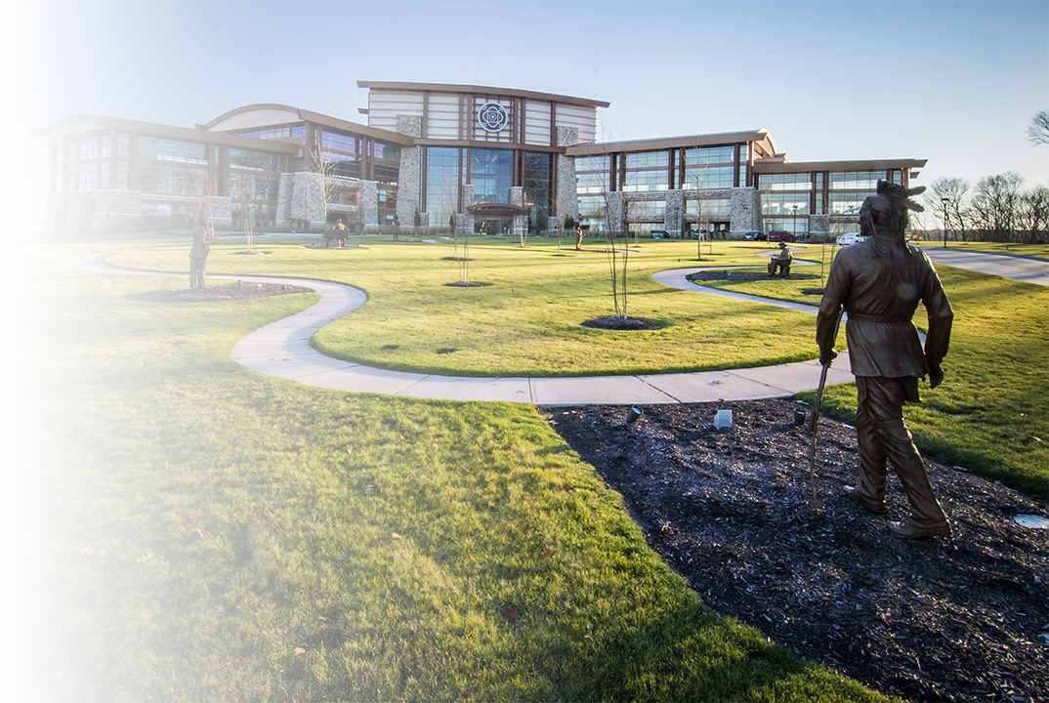
Questions?
Questions?
Rocky W. Chenelle
rocky.chenelle@wdc.usda.gov
Cell: (530) 379-5032

Slide 20
Rocky W. Chenelle | General Field Representative
rocky.chenelle@wdc.usda.gov | Office: 530-379-5032
Rural Development | Telecommunications Program
Rural Utilities Service | U.S. Department of Agriculture
1400 Independence Ave., S.W. | Washington, D.C. 20250
www.rd.usda.gov

